Slide 1
Presentation Task 4
Spyridoula batziou

Slide 2
Introduction
Create a page adding 2 videos inside.
One at the left and the other in a new line on the right.
Add text describing the video content.
Add a background color to the page.

Slide 3

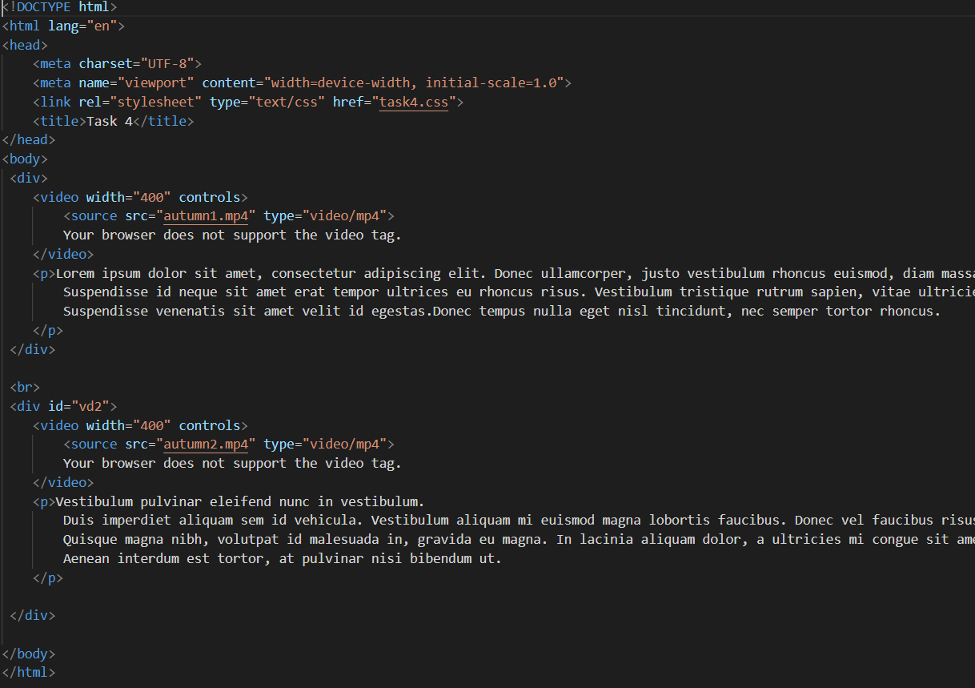
HTML Code
Create 2 div tags with 2 video tags and source tags with name of videos.
Create 2 p tags (paragraph) for description.

Slide 4
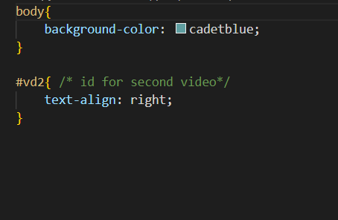
CSS Code
Use body to set background color.
Use #vd2(id for second video) to move it right.

Slide 5
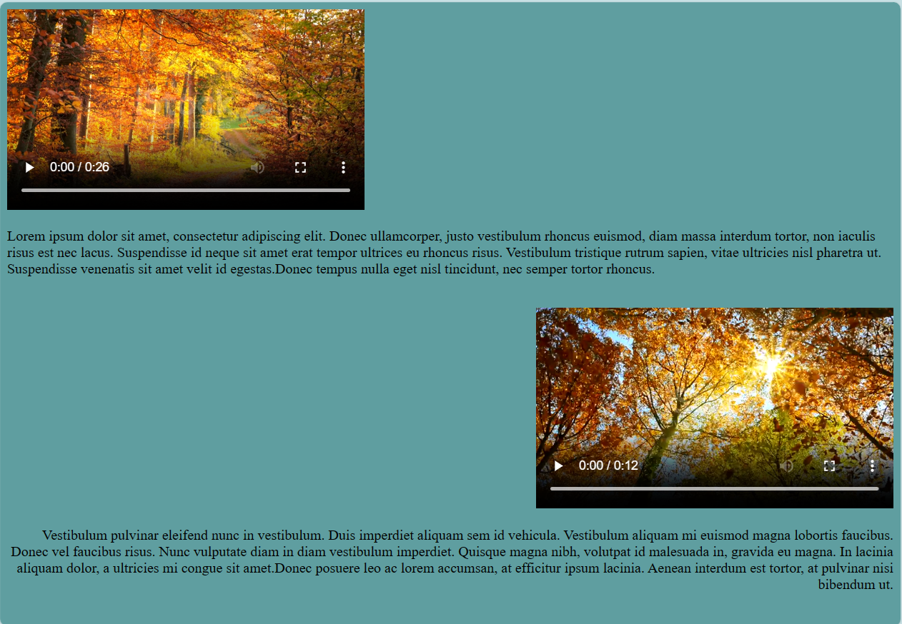
Site

